Slide 1
Chapter 9
Scripting RMAN

Slide 2
Background
Authors felt that scripting was a topic not covered well
Authors wanted to cover both Unix/Linux and Windows environments

Slide 3
Objectives
Scripting basics
Developing Unix shell scripts
Running RMAN within Windows
Scheduling O/S jobs (Unix / Windows)
Creating local and global scripts
Updating stored scripts
Commenting stored scripts
Displaying script information from catalog
Other scripting functions

Slide 4
Scripting RMAN Basics
Means storing scripts in RMAN repository
RMAN catalog database needed
An alternative to O/S shell scripting
Ideal for repetitive tasks, such as:
  Delete archivelog all
  Crosscheck backup
  List copy of datafiles
Not good at parameter passing

Slide 5
Scripting Basics (cont.)
Examples:
  Command file
  Cmdfile options
  Stored scripts

Slide 6
Developing Unix Shell Script
Should be run from automated utility (cron)
Should have notification methods (email)
Should produce output logs
Should be able to back up to multiple mount points
Output logs should be stored on central server
Should be generic to work for any database
Should only be able to run only once at a given time

Slide 7
Developing Shell Script (cont.)
Should include three parameter types:
  Fixed
    Email addresses
    Central log server
  Database specific
    ORACLE_SID / ORACLE_HOME
    Type of backup
    Media type
  Derived
    Determined from previous two parameter types
    For example, location of rman executable

Slide 8

Scheduling a Unix Shell File
One way is via the Unix ‘cron’ facility
  ‘crontab –e’ command (edit)
  crontab –l’ command (list / read)
Crontab format:
Sample cron entry to back up database and archivelogs:

Slide 9
Steps to run RMAN via Windows
Can run with Windows Batch File
  Create RMAN command file
  Call the command file from RMAN command line
  Utility to send email
  Prepare batch file
  Schedule batch file via scheduler
    Windows Scheduler
    ‘at’ command
Can run with GUI in Windows

Slide 10
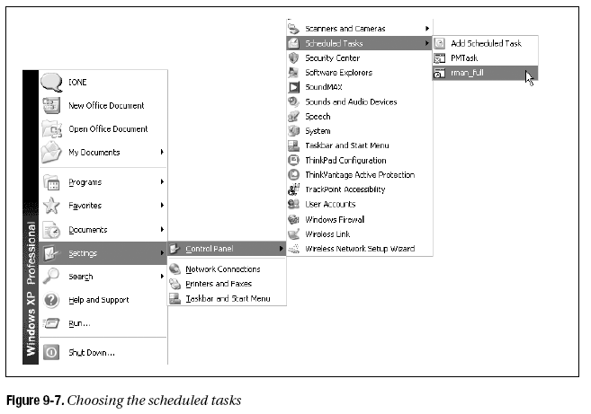
Changing Windows Schedule

Slide 11
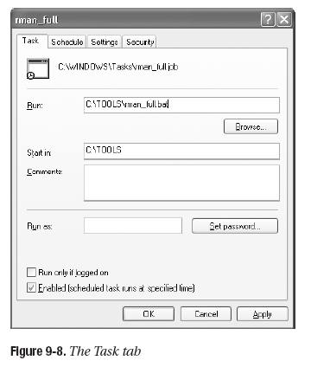
Changing Schedule (cont.)

Slide 12


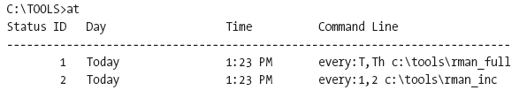
Scheduling - Windows Command Line
Done via ‘at’ command
To schedule:
To view scheduled jobs:

Slide 13
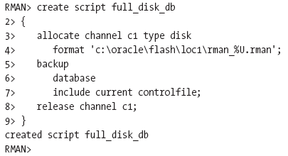
Creating Local-Stored Scripts
First, connect to RMAN target database and catalog:
Second, create the stored script:

Slide 14
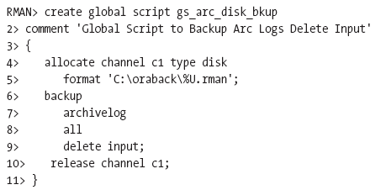
Creating a Global Script
Can be called for any target database

Slide 15
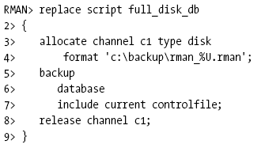
Updating Stored Scripts
Done via ‘replace script’ command:

Slide 16
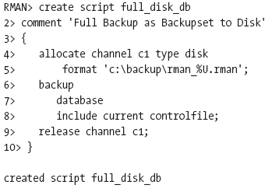
Commenting Stored Scripts
Done via ‘comment’ command:

Slide 17
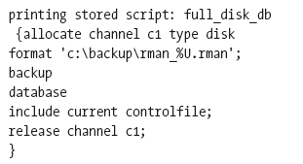
Displaying Stored Scripts
Done via ‘print script’ command

Slide 18
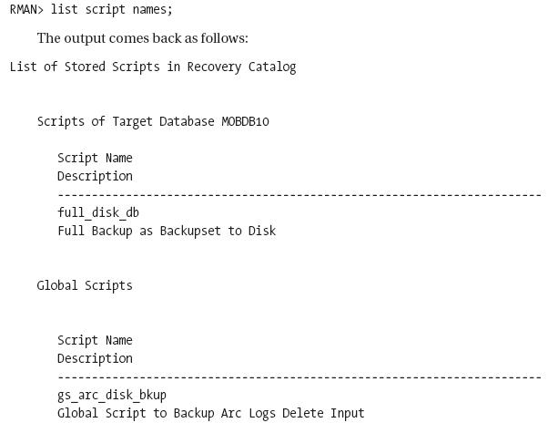
Getting Listing of Scripts
Done via ‘list script’ command:

Slide 19

Dropping Stored Scripts
Done via ‘delete script’ command:

Slide 20
Other Scripting Functions
Executing like-named scripts (one global, one local)
Converting stored scripts to files
Creating/Replacing stored script from file
Passing parameters to stored scripts
Creating parameterized command file script

Slide 21
The Flash Recovery Area
Used by database as backup location
  Backup sets
  Image copies
  Archivelogs
Automatically deletes unneeded backups
Can store redo logs (online/archived and control files
Optional backup area
Configure in different location than database files

Slide 22

Creating Flash Recovery Area
Factors to evaluate before creating:
  Where should it be created
  How much space should be allocated
Basic tasks:
  Disable archive destination parameters
  Run command to create the FRA:

Slide 23
Writing Backups to FRA
Run backup without specifying ‘format’ option
Automatically Creates directories under FRA base:
  Database name
    Backupset (for backup sets)
    Datafile (for image copies)
    Autobackup (for control files)
    Flashback (for flashback logs)
    Archivelog
    Controlfile
    onlinelog

Slide 24


What if FRA runs out of space?
Increase space
Remove restore points (older ones)
Disable flashback

Slide 25
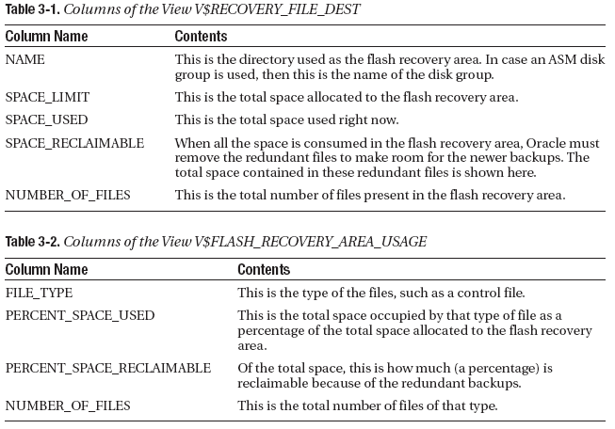
Checking FRA Space Usage

Slide 26

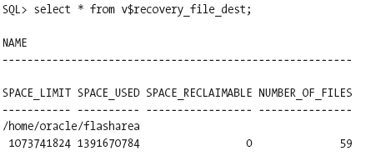
Expanding/Shrinking FRA

Slide 27
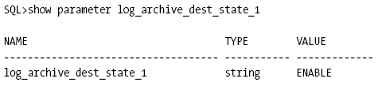
Placing Archived Logs in FRA
Use ‘alter system’:
Validate that destination is enabled:

Slide 28
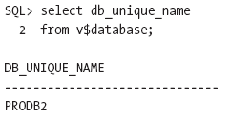
Using Same FRA for Two Databases with Same Name
First, find validate unique database name:
Then, alter initialization parameter of one database:

Slide 29
Placing Control File in FRA
Accomplished three ways:
  When database is created
  When control file recreated via SQL script when recovering from a failure
  When control file is restored from backup
Then, reflect in initialization parameter file:
  Via control files parameter
  Via db_create_file_dest parameter
    Validate that db_create_online_log_dest_[12] not used

Slide 30
Placing Online Redo Logs in FRA
Can be done at database creation via parameters:
Can be done when adding a group
  Make sure db_recovery_file_dest is set
  Make sure db_file_create_dest is NULL
  Make sure db_create_online_log_dest_* are NULL
  Issue statement to add logfile group:

Slide 31
Sending Image Copies to FRA
Two easy steps!
  Ensure flash recovery area is configured
  Ensure RMAN script has no ‘format’ command in channel configuration

Slide 32
Deleting from the FRA
For backup sets:
  First, get list of backups with ‘list backupset’ command
  Issue ‘delete backupset; command:
For archive logs:
  First, get list of backed up logs with ‘list archivelog all’ command
  Issue ‘delete archivelog command’:

Slide 33
Reinstating Damaged Datafile
Check files of database with ‘report schema’
Follow steps to recover file:

Slide 34
Switching Back from Image Copy
Check files of database with ‘report schema’
Follow steps to switch file back:
  Remove original OS file, if present
  Backup copy of file
  Take the datafile offline
  Issue ‘switch datafile’ command for that datafile
  Issue ‘recover datafile’ command for that datafile
  Bring datafile back online
  Check location once again with ‘report schema’

Slide 35

Backing up the FRA to Tape
Done via ‘backup recovery area’ command:

Slide 36
Sizing the FRA
Files to be concerned with:
  Copy of all datafiles
  Incremental backups, if configured
  Flashback logs (if enabled)
  Online redo logs
  Archived redo logs not backed up to tape
  Control files
  Controlfile autobackups

Slide 37
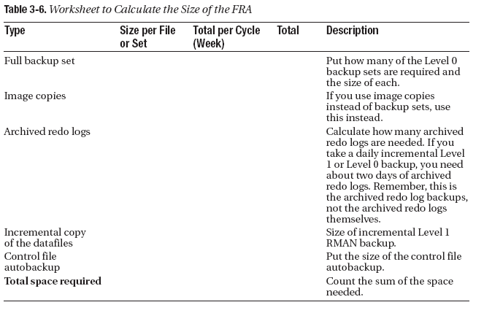
Sizing the FRA (cont.)

